Slide 1
Digital Logic Design Gate-Level Minimization

Slide 2
3-1 Introduction
Gate-level minimization refers to the design task of finding an optimal gate-level implementation of Boolean functions describing a digital circuit.

Slide 3
3-2 The Map Method
The complexity of the digital logic gates
The complexity of the algebraic expression
Logic minimization
Algebraic approaches: lack specific rules
The Karnaugh map
A simple straight forward procedure
A pictorial form of a truth table
Applicable if the # of variables < 7
A diagram made up of squares
Each square represents one minterm

Slide 4
Review of Boolean Function
Boolean function
Sum of minterms
Sum of products (or product of sum) in the simplest form
A minimum number of terms
A minimum number of literals
The simplified expression may not be unique

Slide 5
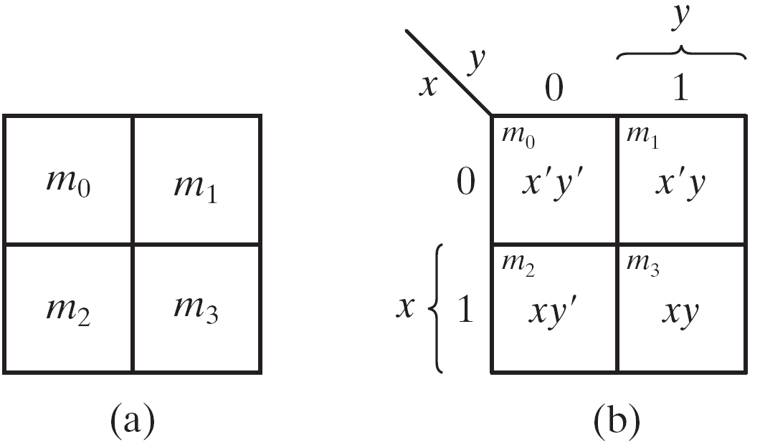
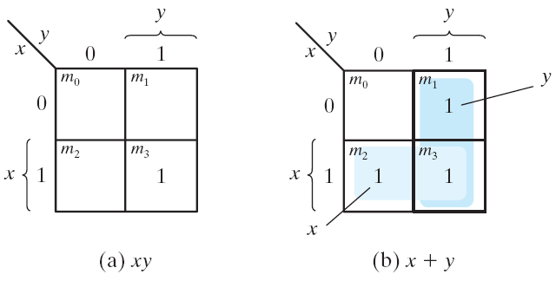
Two-Variable Map
A two-variable map
Four minterms
x' = row 0; x = row 1
y' = column 0; y = column 1
A truth table in square diagram
Fig. 3.2(a): xy = m₃
Fig. 3.2(b): x+y = x'y+xy' +xy = m₁+m₂+m₃
Figure 3.1 Two-variable Map
Figure 3.2 Representation of functions in the map

Slide 6
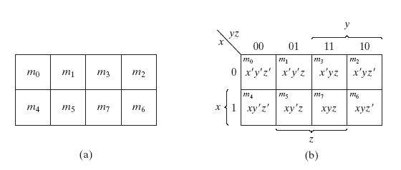
A Three-variable Map
Figure 3.3 Three-variable Map
A three-variable map
Eight minterms
The Gray code sequence
Any two adjacent squares in the map differ by only on variable
Primed in one square and unprimed in the other
e.g., m₅ and m₇ can be simplified
m₅+ m₇ = xy'z + xyz = xz (y'+y) = xz

Slide 7
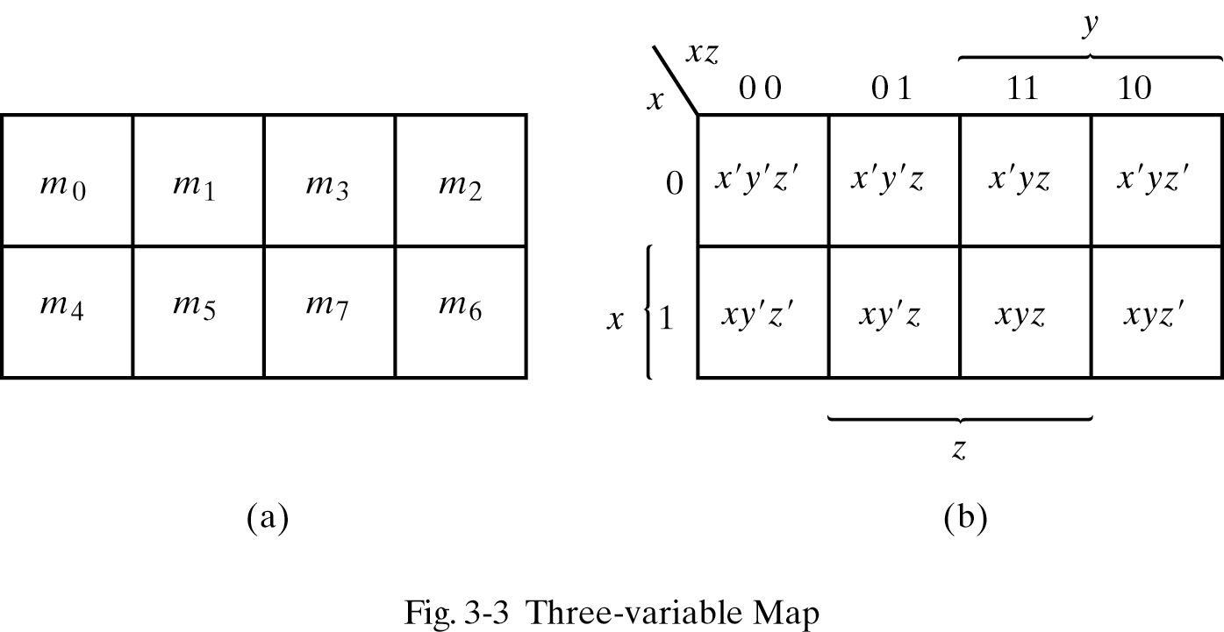
A Three-variable Map
m₀ and m₂ (m₄ and m₆) are adjacent
m₀+ m₂ = x'y'z' + x'yz' = x'z' (y'+y) = x'z'
m₄+ m₆ = xy'z' + xyz' = xz' (y'+y) = xz'

Slide 8
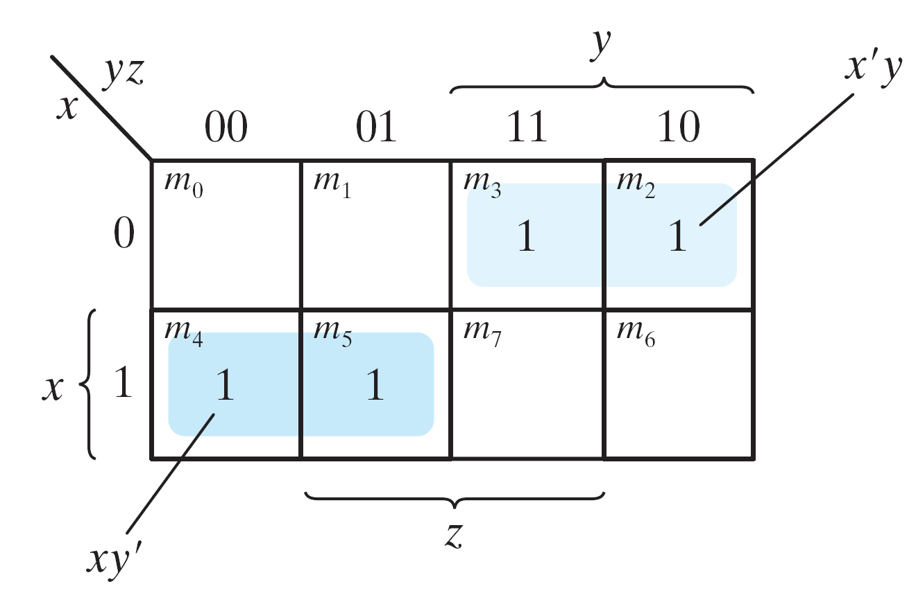
Example 3.1
Figure 3.4 Map for Example 3.1, F(x, y, z) = Σ(2, 3, 4, 5) = x'y + xy'
Example 3.1: simplify the Boolean function F(x, y, z) = Σ(2, 3, 4, 5)
F(x, y, z) = Σ(2, 3, 4, 5) = x'y + xy'

Slide 9
Example 3.2
Figure 3.5 Map for Example 3-2; F(x, y, z) = Σ(3, 4, 6, 7) = yz + xz'
Example 3.2: simplify F(x, y, z) = Σ(3, 4, 6, 7)
F(x, y, z) = Σ(3, 4, 6, 7) = yz+ xz'

Slide 10
Four adjacent Squares
Figure 3.3 Three-variable Map
Consider four adjacent squares
2, 4, and 8 squares
m₀+m₂+m₄+m₆ = x'y'z'+x'yz'+xy'z'+xyz' = x'z'(y'+y) +xz'(y'+y) = x'z' + xz‘ = z'
m₁+m₃+m₅+m₇ = x'y'z+x'yz+xy'z+xyz =x'z(y'+y) + xz(y'+y) =x'z + xz = z

Slide 11
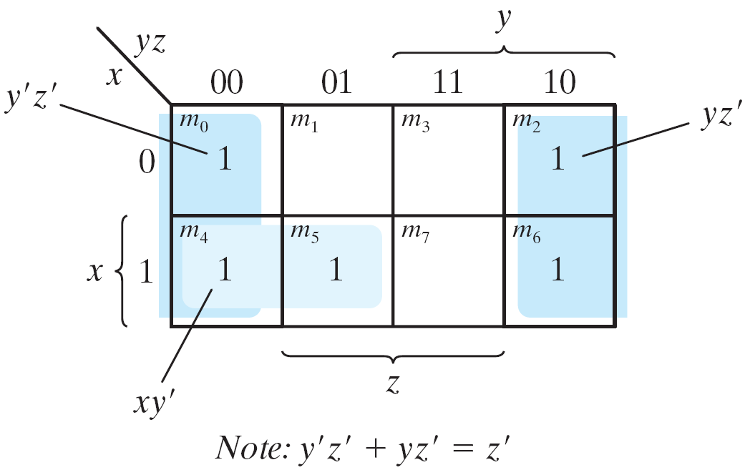
Example 3.3
Example 3.3: simplify F(x, y, z) = Σ(0, 2, 4, 5, 6)
F(x, y, z) = Σ(0, 2, 4, 5, 6) = z'+ xy'
Figure 3.6 Map for Example 3-3, F(x, y, z) = Σ(0, 2, 4, 5, 6) = z' +xy'

Slide 12
Example 3.4
Figure 3.7 Map for Example 3.4, A'C + A'B + AB'C + BC = C + A'B
Example 3.4: let F = A'C + A'B + AB'C + BC
Express it in sum of minterms.
Find the minimal sum of products expression.
Ans:
F(A, B, C) = Σ(1, 2, 3, 5, 7) = C + A'B

Slide 13
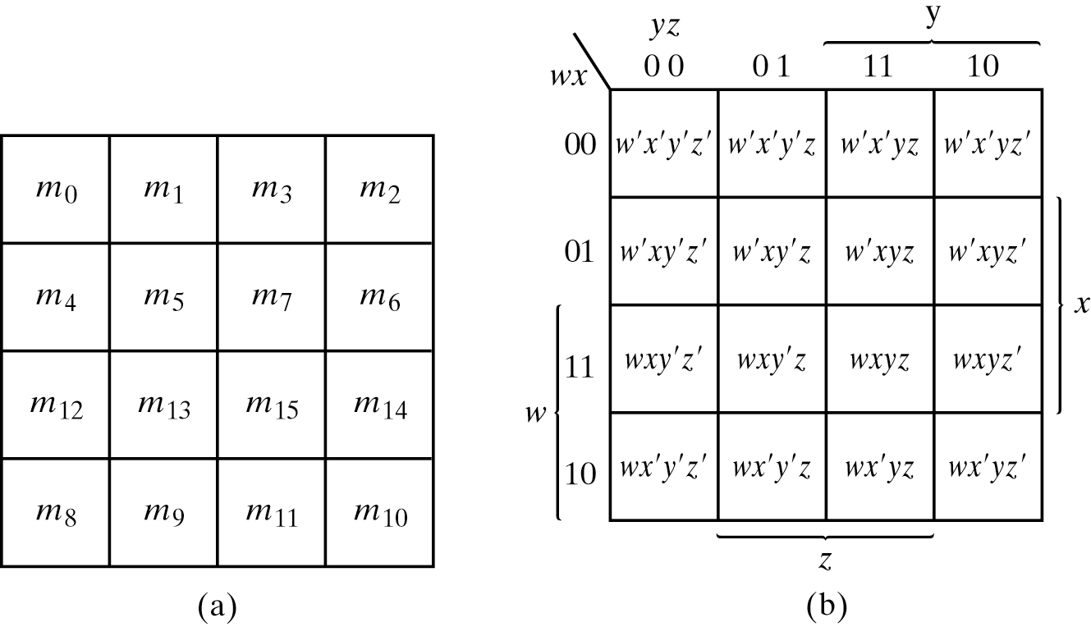
3.3 Four-Variable Map
Figure 3.8 Four-variable Map
The map
16 minterms
Combinations of 2, 4, 8, and 16 adjacent squares

Slide 14
Example 3.5
F = y'+w'z'+xz'
Figure 3.9 Map for Example 3-5; F(w, x, y, z) = Σ(0, 1, 2, 4, 5, 6, 8, 9, 12, 13, 14) = y' + w' z' +xz'
Example 3.5: simplify F(w, x, y, z) = Σ(0, 1, 2, 4, 5, 6, 8, 9, 12, 13, 14)

Slide 15
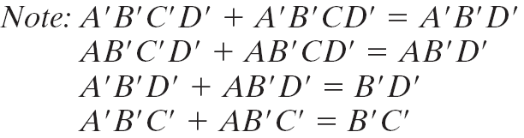
Example 3.6
Figure 3.9 Map for Example 3-6; A′B′C′ + B′CD′ + A′B′C′D′ + AB′C′= B′D′ + B′C′ +A′CD′
Example 3-6: simplify F = A′B′C′ + B′CD′ + A′B′C′D′ + AB′C′

Slide 16
Prime Implicants
Prime Implicants
All the minterms are covered.
Minimize the number of terms.
A prime implicant: a product term obtained by combining the maximum possible number of adjacent squares (combining all possible maximum numbers of squares).
Essential P.I.: a minterm is covered by only one prime implicant.
The essential P.I. must be included.

Slide 17
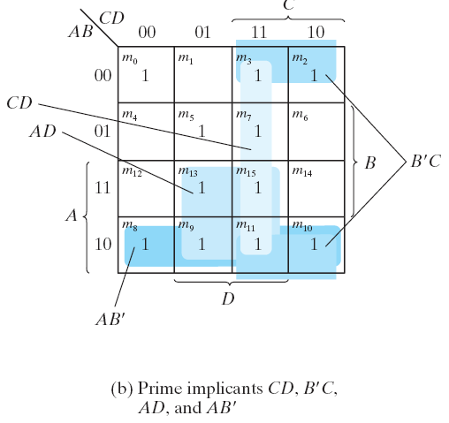
Prime Implicants
Figure 3.11 Simplification Using Prime Implicants
Consider F(A, B, C, D) = Σ(0, 2, 3, 5, 7, 8, 9, 10, 11, 13, 15)
The simplified expression may not be unique
F = BD+B'D'+CD+AD = BD+B'D'+CD+AB'
= BD+B'D'+B'C+AD = BD+B'D'+B'C+AB'

Slide 18
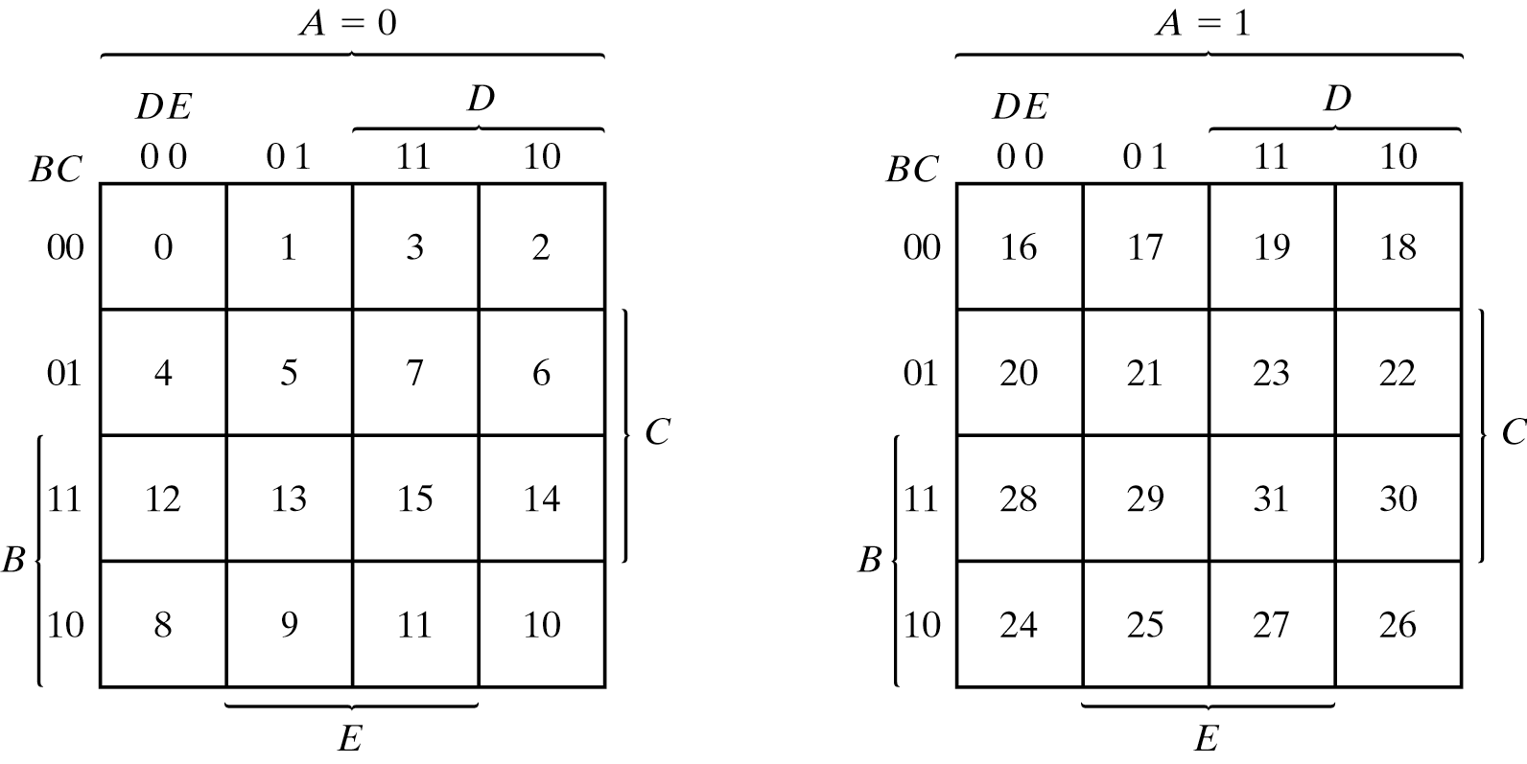
3.4 Five-Variable Map
Figure 3.12 Five-variable Map
Map for more than four variables becomes complicated
Five-variable map: two four-variable map (one on the top of the other).

Slide 19
Table 3.1 shows the relationship between the number of adjacent squares and the number of literals in the term.

Slide 20
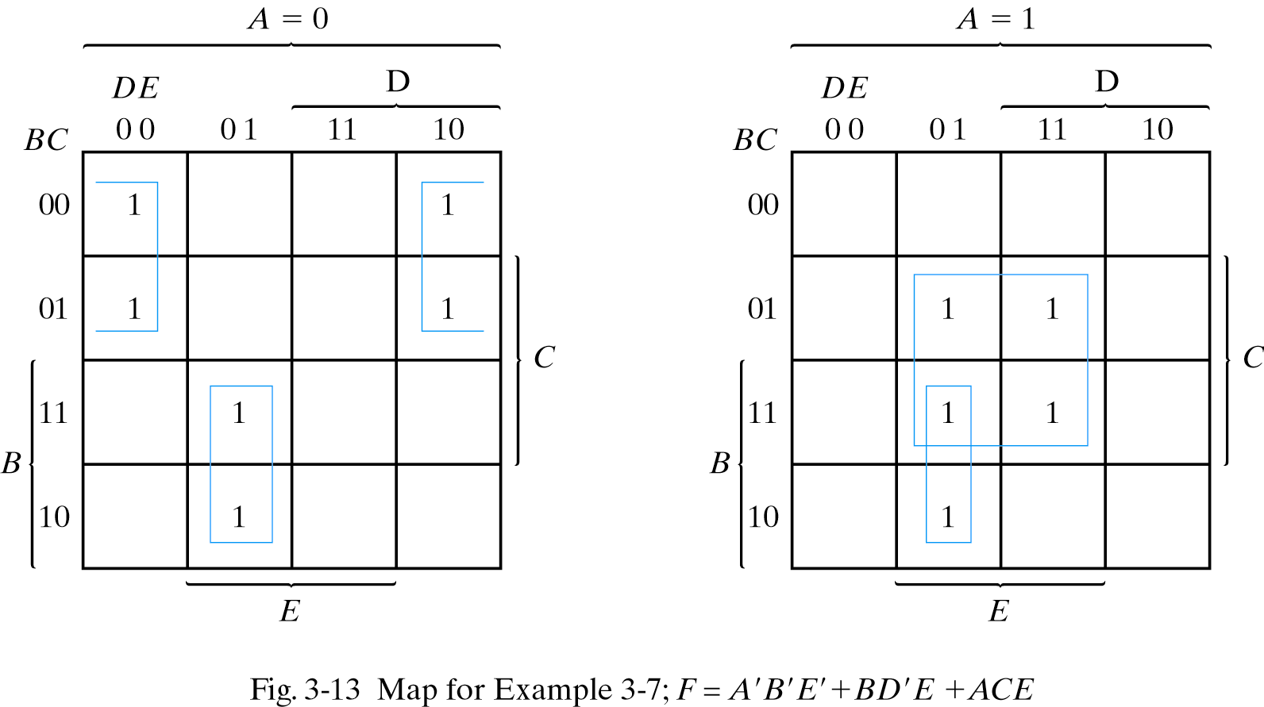
Example 3.7
F = A'B'E'+BD'E+ACE
Example 3.7: simplify F = Σ(0, 2, 4, 6, 9, 13, 21, 23, 25, 29, 31)

Slide 21
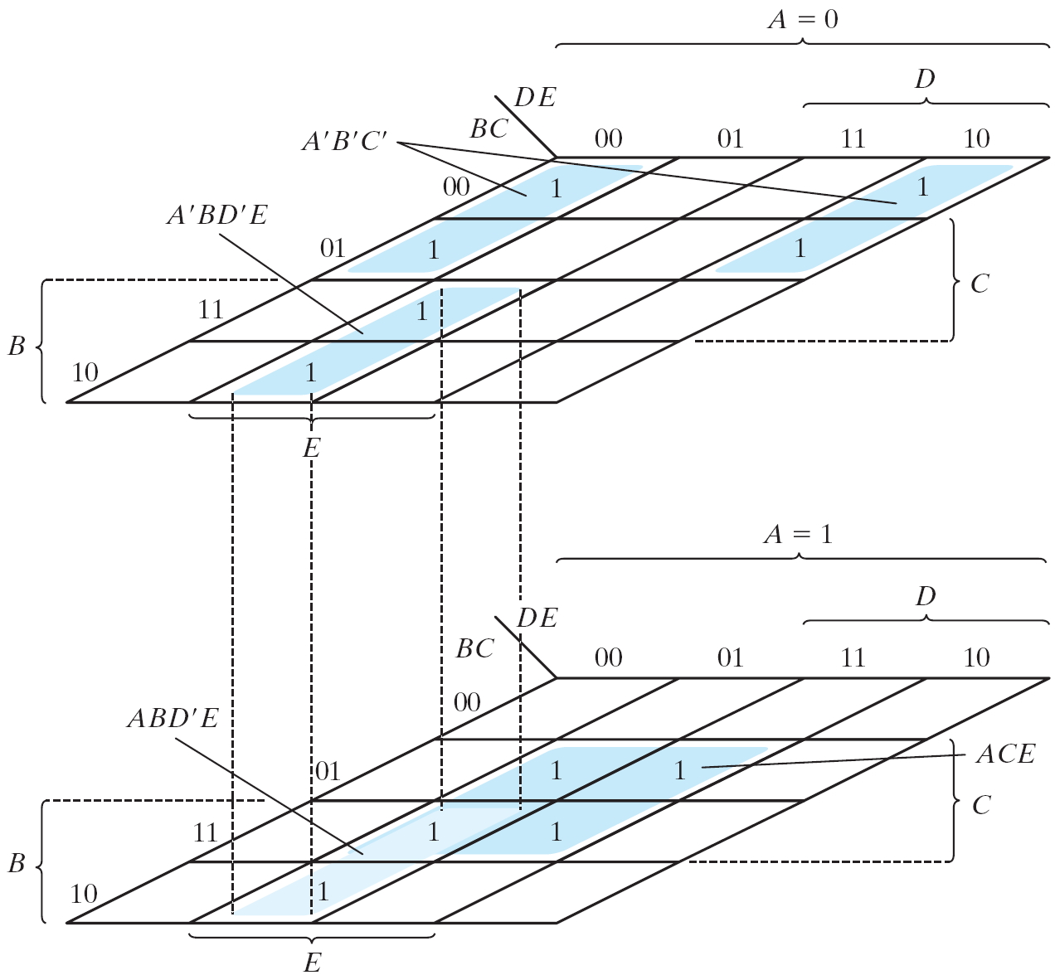
Example 3.7 (cont.)
Figure 3.13 Map for Example 3.7, F = A'B'E'+BD'E+ACE
Another Map for Example 3-7

Slide 22
3-5 Product of Sums Simplification
Approach #1
Simplified F' in the form of sum of products
Apply DeMorgan's theorem F = (F')'
F': sum of products → F: product of sums
Approach #2: duality
Combinations of maxterms (it was minterms)
M₀M₁ = (A+B+C+D)(A+B+C+D') = (A+B+C)+(DD') = A+B+C
CD
AB
00
01
11
10
00
M₀ | M₁ | M₃ | M₂
M₄ | M₅ | M₇ | M₆
M₁₂ | M₁₃ | M₁₅ | M₁₄
M₈ | M₉ | M₁₁ | M₁₀
01
11
10

Slide 23
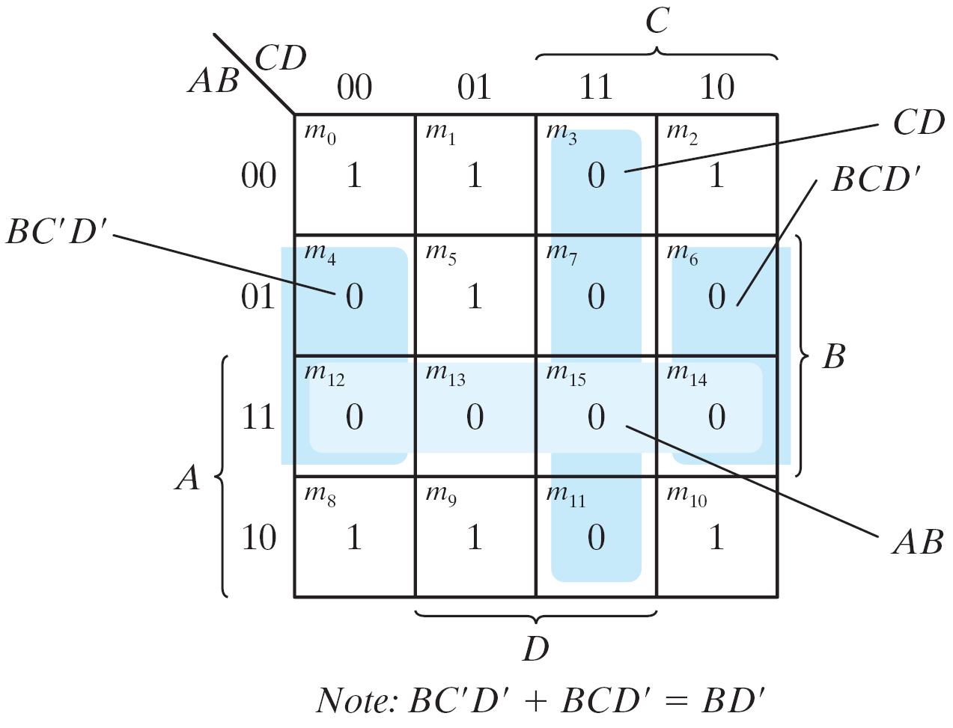
Example 3.8
F(A, B, C, D)= Σ(0, 1, 2, 5, 8, 9, 10) = B'D'+B'C'+A'C'D
F' = AB+CD+BD'
Apply DeMorgan's theorem; F=(A'+B')(C'+D')(B'+D)
Or think in terms of maxterms
Figure 3.14 Map for Example 3.8, F(A, B, C, D)= Σ(0, 1, 2, 5, 8, 9, 10) = B'D'+B'C'+A'C'D
Example 3.8: simplify F = Σ(0, 1, 2, 5, 8, 9, 10) into (a) sum-of-products form, and (b) product-of-sums form:

Slide 24
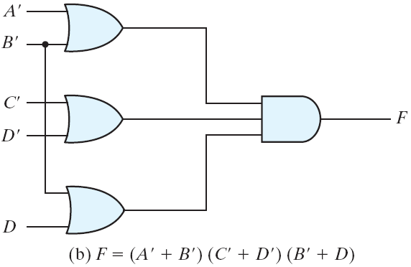
Example 3.8 (cont.)
Sum-of products form
Product-of sums form
Figure 3.15 Gate Implementation of the Function of Example 3.8
Gate implementation of the function of Example 3.8

Slide 25
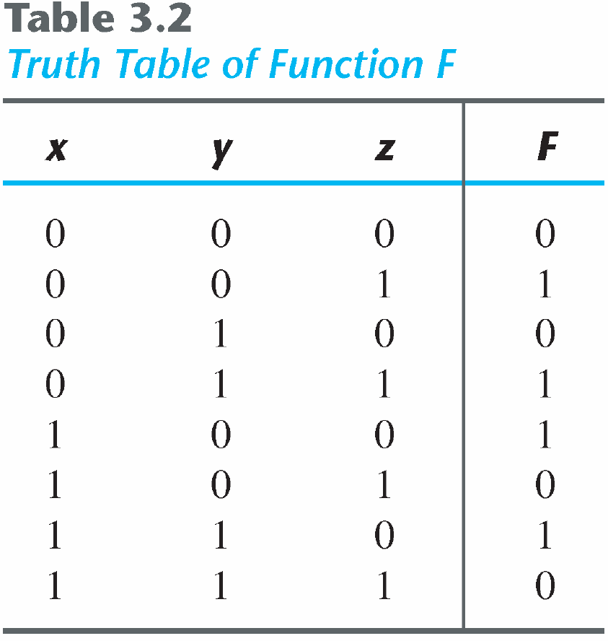
Sum-of-Minterm Procedure
Consider the function defined in Table 3.2.
In sum-of-minterm:
In sum-of-maxterm:
Taking the complement of F′

Slide 26
Sum-of-Minterm Procedure
'
Figure 3.16 Map for the function of Table 3.2
Consider the function defined in Table 3.2.
Combine the 1’s:
Combine the 0’s :

Slide 27
3-6 Don't-Care Conditions
The value of a function is not specified for certain combinations of variables
BCD; 1010-1111: don't care
The don't-care conditions can be utilized in logic minimization
Can be implemented as 0 or 1
Example 3.9: simplify F(w, x, y, z) = Σ(1, 3, 7, 11, 15) which has the don't-care conditions d(w, x, y, z) = Σ(0, 2, 5).

Slide 28
Example 3.9 (cont.)
Figure 3.17 Example with don't-care Conditions
F = yz + w'x'; F = yz + w'z
F = Σ(0, 1, 2, 3, 7, 11, 15) ; F = Σ(1, 3, 5, 7, 11, 15)
Either expression is acceptable

Slide 29
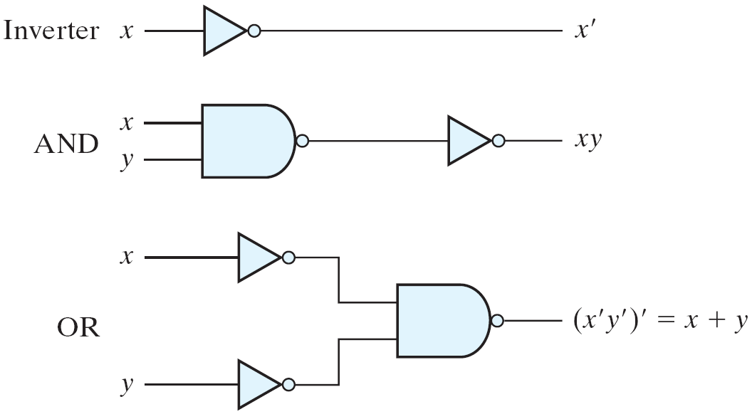
3-7 NAND and NOR Implementation
Figure 3.18 Logic Operations with NAND Gates
NAND gate is a universal gate
Can implement any digital system

Slide 30
NAND Gate
Figure 3.19 Two Graphic Symbols for NAND Gate
Two graphic symbols for a NAND gate

Slide 31
Two-level Implementation
Figure 3.20 Three ways to implement F = AB + CD
Two-level logic
NAND-NAND = sum of products
Example: F = AB+CD
F = ((AB)' (CD)' )' =AB+CD

Slide 32
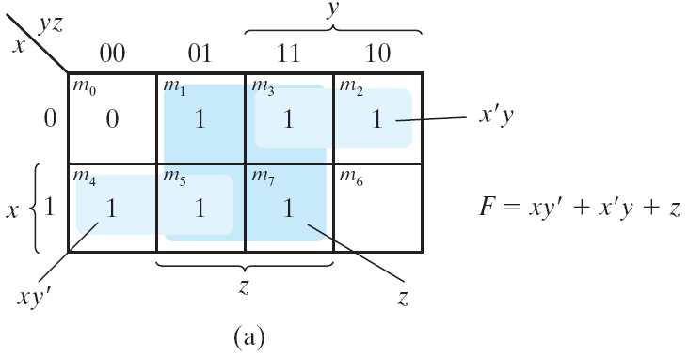
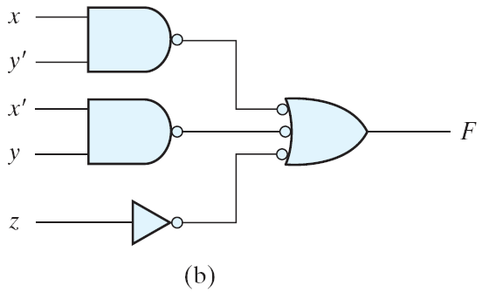
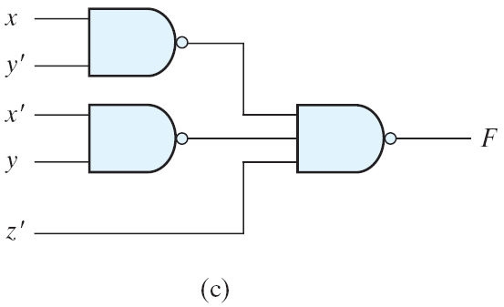
Example 3.10
Figure 3.21 Solution to Example 3-10
Example 3-10: implement F(x, y, z) =

Slide 33
Procedure with Two Levels NAND
The procedure
Simplified in the form of sum of products;
A NAND gate for each product term; the inputs to each NAND gate are the literals of the term (the first level);
A single NAND gate for the second sum term (the second level);
A term with a single literal requires an inverter in the first level.

Slide 34
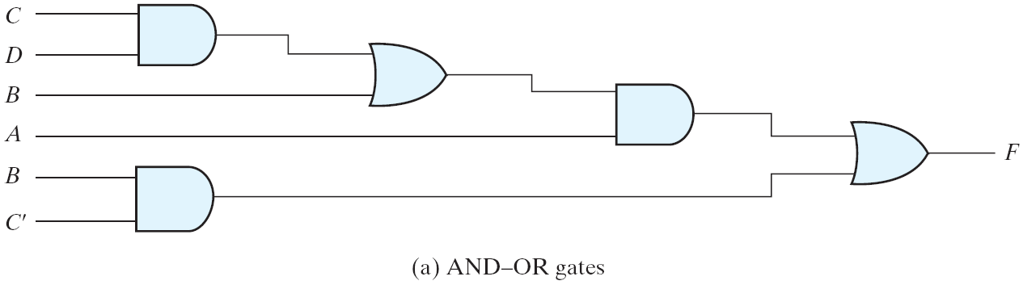
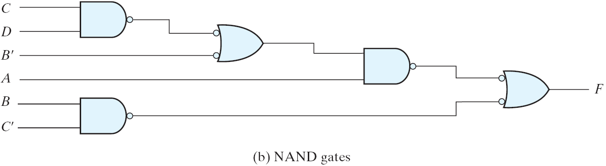
Multilevel NAND Circuits
Figure 3.22 Implementing F = A(CD + B) + BC′
Boolean function implementation
AND-OR logic → NAND-NAND logic
AND → AND + inverter
OR: inverter + OR = NAND
For every bubble that is not compensated by another small circle along the same line, insert an inverter.

Slide 35
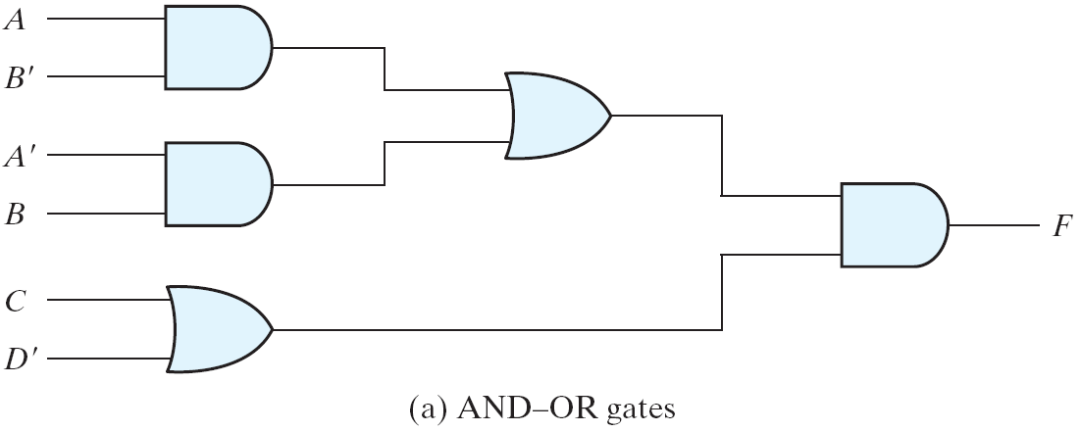
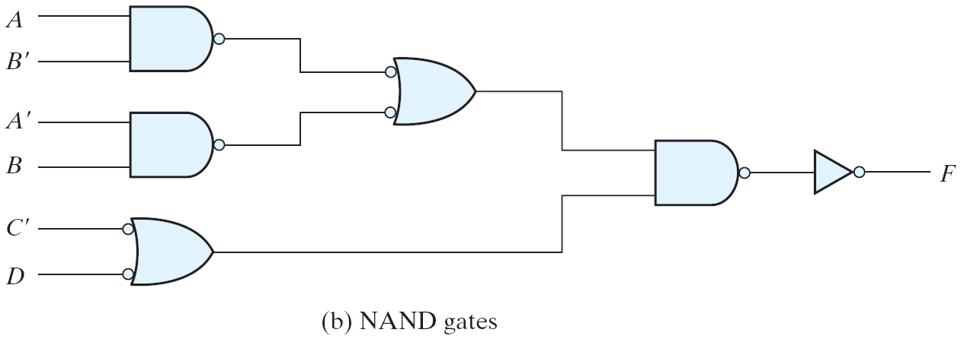
NAND Implementation
Figure 3.23 Implementing F = (AB′ +A′B)(C+ D′)

Slide 36
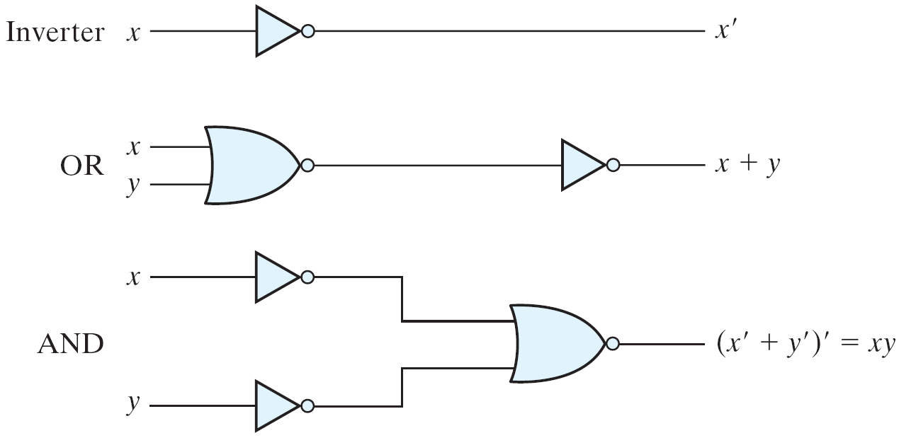
NOR Implementation
Figure 3.24 Logic Operation with NOR Gates
NOR function is the dual of NAND function.
The NOR gate is also universal.

Slide 37
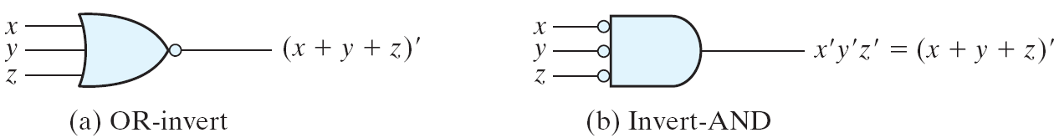
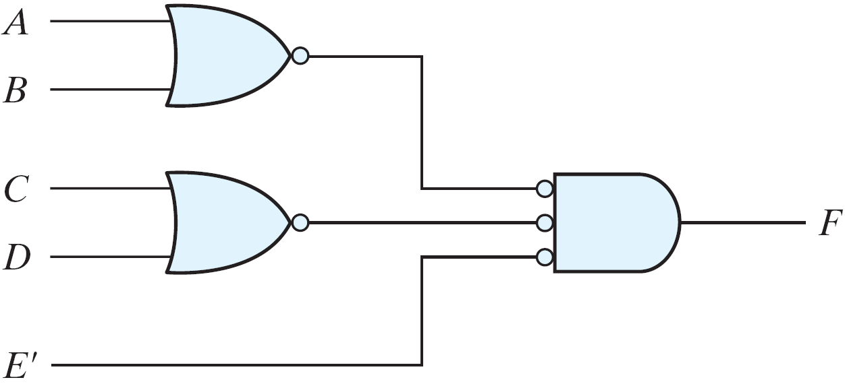
Two Graphic Symbols for a NOR Gate
Figure 3.25 Two Graphic Symbols for NOR Gate
Example: F = (A + B)(C + D)E
Figure 3.26 Implementing F = (A + B)(C + D)E

Slide 38
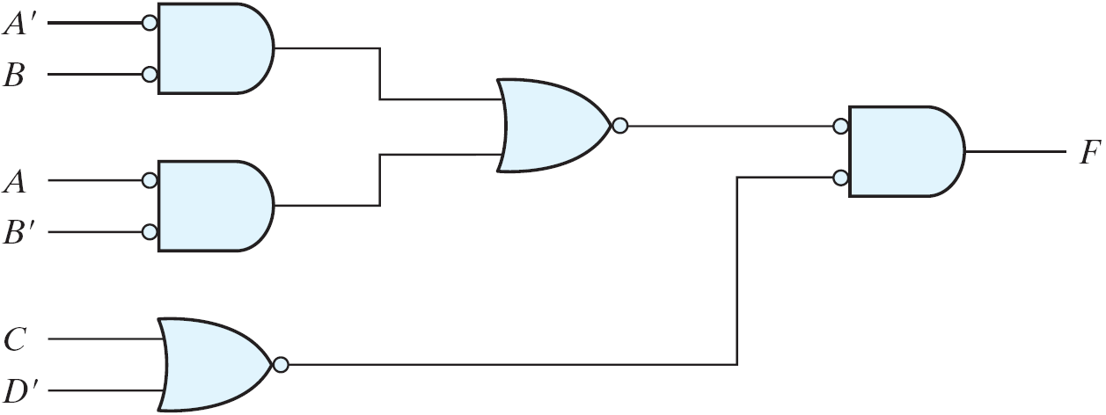
Example
Example: F = (AB′ +A′B)(C + D′)
Figure 3.27 Implementing F = (AB′ +A′B)(C + D′) with NOR gates

Slide 39
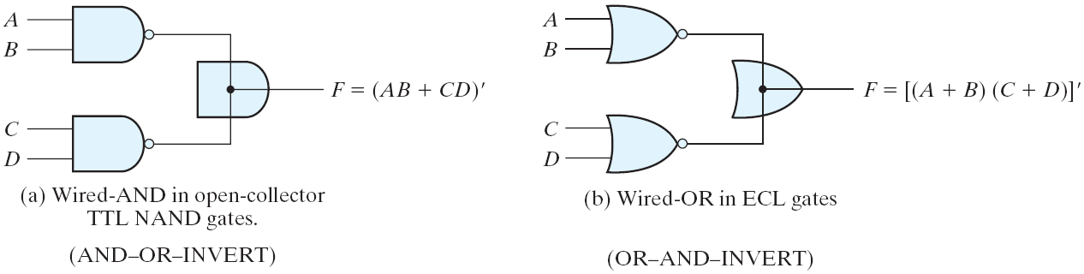
3-8 Other Two-level Implementations (
AND-OR-INVERT function
OR-AND-INVERT function
Figure 3.28 Wired Logic
Wired logic
A wire connection between the outputs of two gates
Open-collector TTL NAND gates: wired-AND logic
The NOR output of ECL gates: wired-OR logic

Slide 40
Non-degenerate Forms
16 possible combinations of two-level forms
Eight of them: degenerate forms = a single operation
AND-AND, AND-NAND, OR-OR, OR-NOR, NAND-OR, NAND-NOR, NOR-AND, NOR-NAND.
The eight non-degenerate forms
AND-OR, OR-AND, NAND-NAND, NOR-NOR, NOR-OR, NAND-AND, OR-NAND, AND-NOR.
AND-OR and NAND-NAND = sum of products.
OR-AND and NOR-NOR = product of sums.
NOR-OR, NAND-AND, OR-NAND, AND-NOR = ?

Slide 41
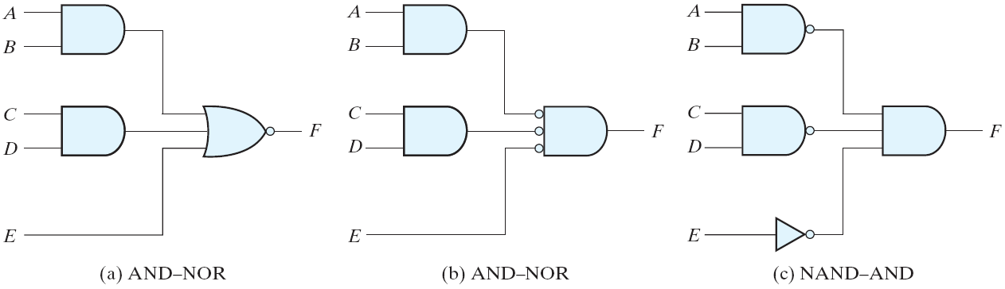
AND-OR-Invert Implementation
Figure 3.29 AND-OR-INVERT circuits, F = (AB +CD +E)′
AND-OR-INVERT (AOI) Implementation
NAND-AND = AND-NOR = AOI
F = (AB+CD+E)'
F' = AB+CD+E (sum of products)

Slide 42
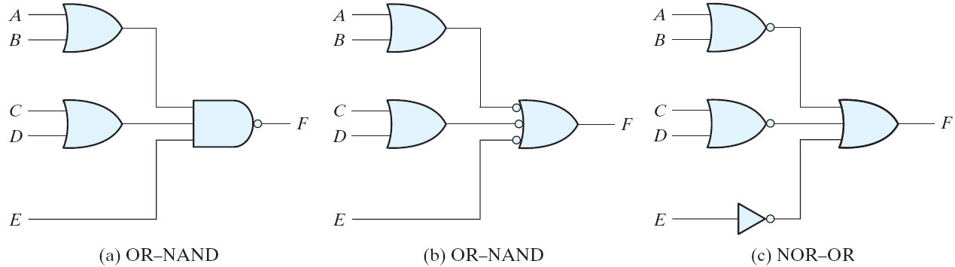
OR-AND-Invert Implementation
Figure 3.30 OR-AND-INVERT circuits, F = ((A+B)(C+D)E)'
OR-AND-INVERT (OAI) Implementation
OR-NAND = NOR-OR = OAI
F = ((A+B)(C+D)E)'
F' = (A+B)(C+D)E (product of sums)

Slide 43
Tabular Summary and Examples
Example 3-11: F = x'y'z'+xyz'
F' = x'y+xy'+z (F': sum of products)
F = (x'y+xy'+z)' (F: AOI implementation)
F = x'y'z' + xyz' (F: sum of products)
F' = (x+y+z)(x'+y'+z) (F': product of sums)
F = ((x+y+z)(x'+y'+z))' (F: OAI)

Slide 44
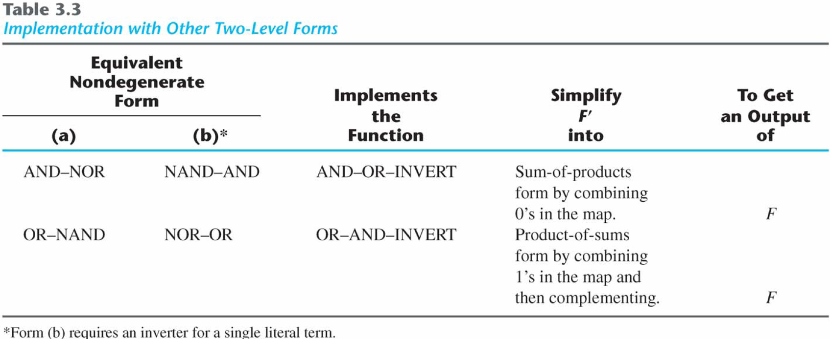
Tabular Summary and Examples

Slide 45
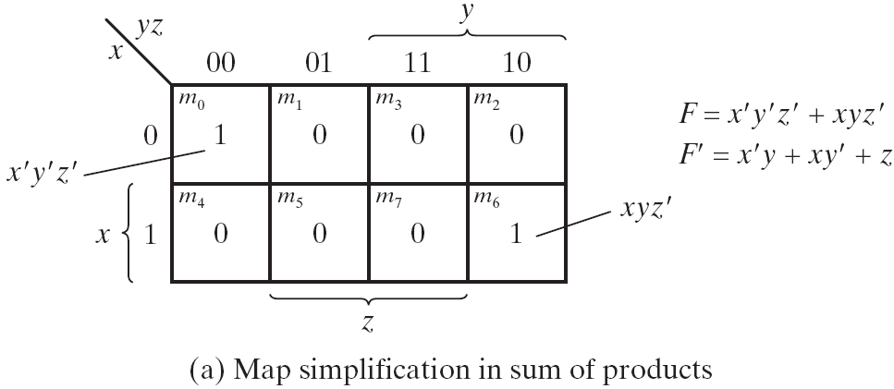
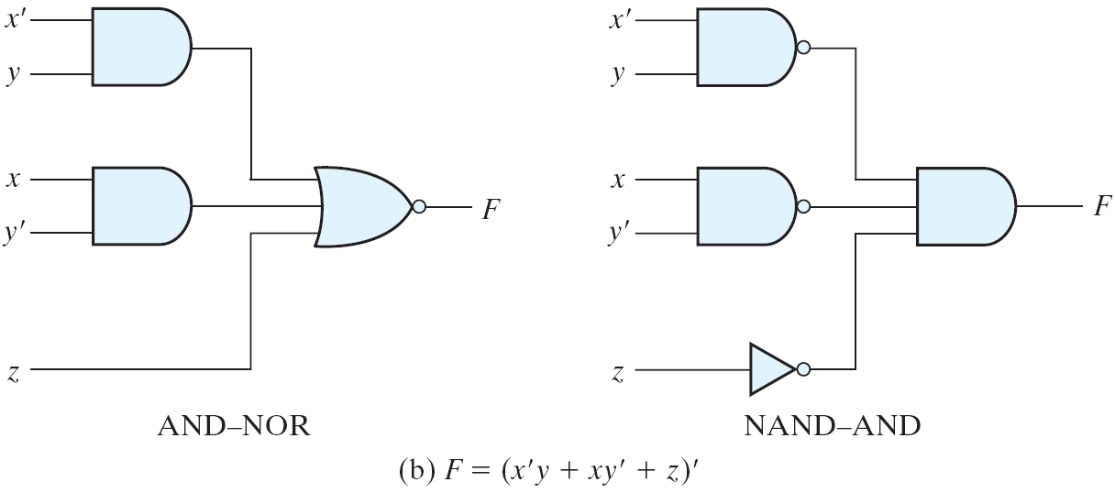
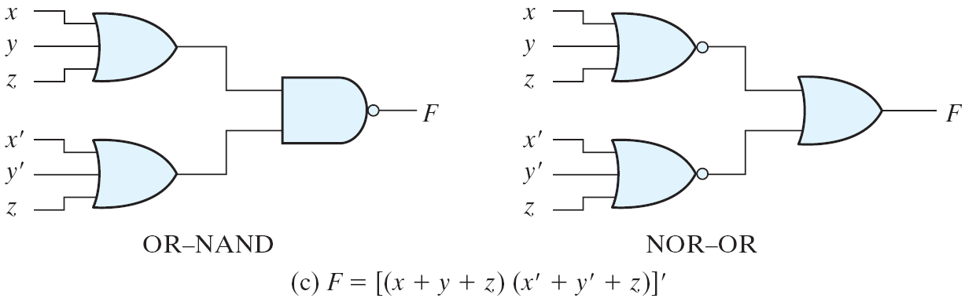
Figure 3.31 Other Two-level Implementations

Slide 46
3-9 Exclusive-OR Function
Exclusive-OR (XOR)
x⊕y = xy'+x'y
Exclusive-NOR (XNOR)
(x⊕y)' = xy + x'y'
Some identities
x⊕0 = x
x⊕1 = x'
x⊕x = 0
x⊕x' = 1
x⊕y' = (x⊕y)'
x'⊕y = (x⊕y)'
Commutative and associative
A⊕B = B⊕A
(A⊕B) ⊕C = A⊕ (B⊕C) = A⊕B⊕C

Slide 47
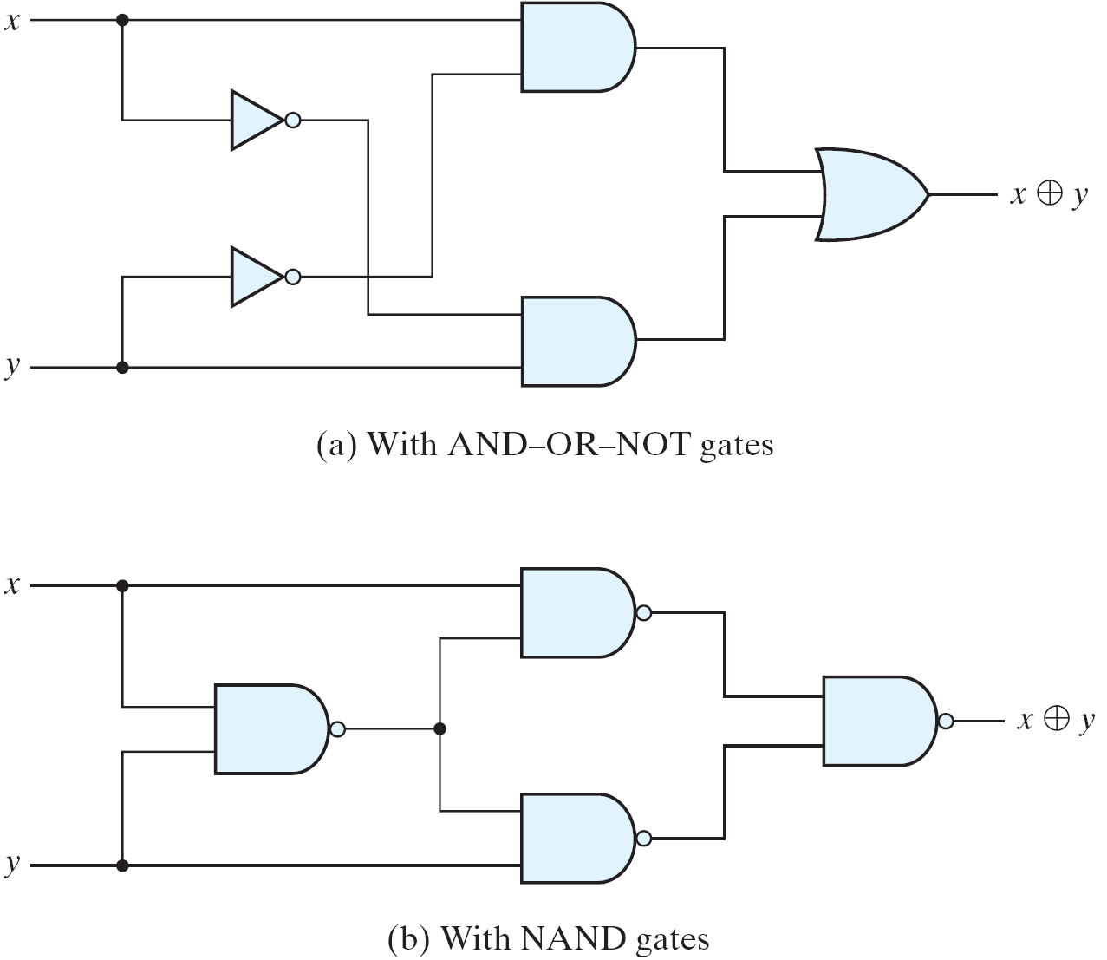
Exclusive-OR Implementations
Figure 3.32 Exclusive-OR Implementations
Implementations
(x'+y')x + (x'+y')y = xy'+x'y = x⊕y

Slide 48
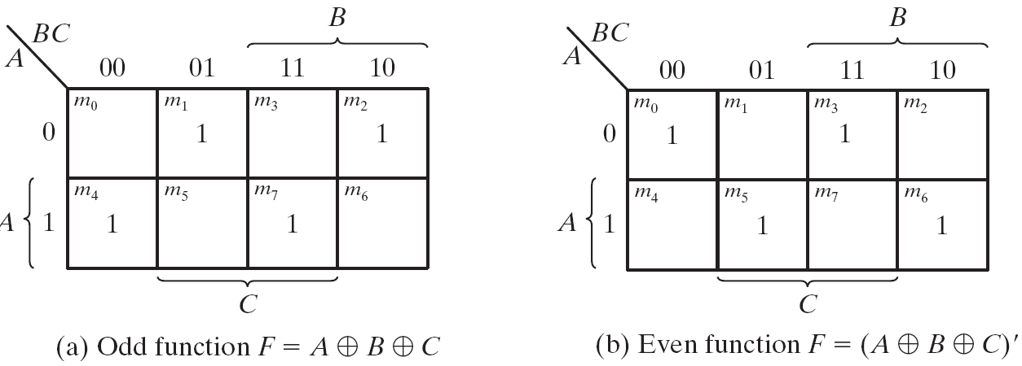
Odd Function
Figure 3.33 Map for a Three-variable Exclusive-OR Function
A⊕B⊕C = (AB'+A'B)C' +(AB+A'B')C = AB'C'+A'BC'+ABC+A'B'C = Σ(1, 2, 4, 7)
XOR is a odd function → an odd number of 1's, then F = 1.
XNOR is a even function → an even number of 1's, then F = 1.

Slide 49
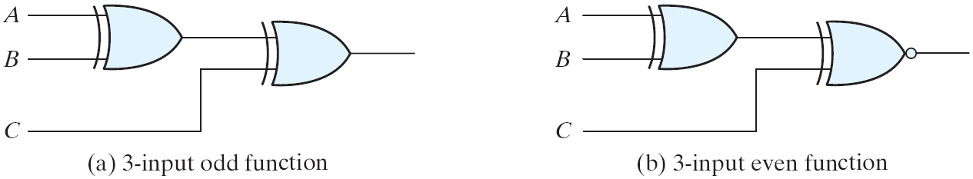
XOR and XNOR
Figure 3.34 Logic Diagram of Odd and Even Functions
Logic diagram of odd and even functions

Slide 50
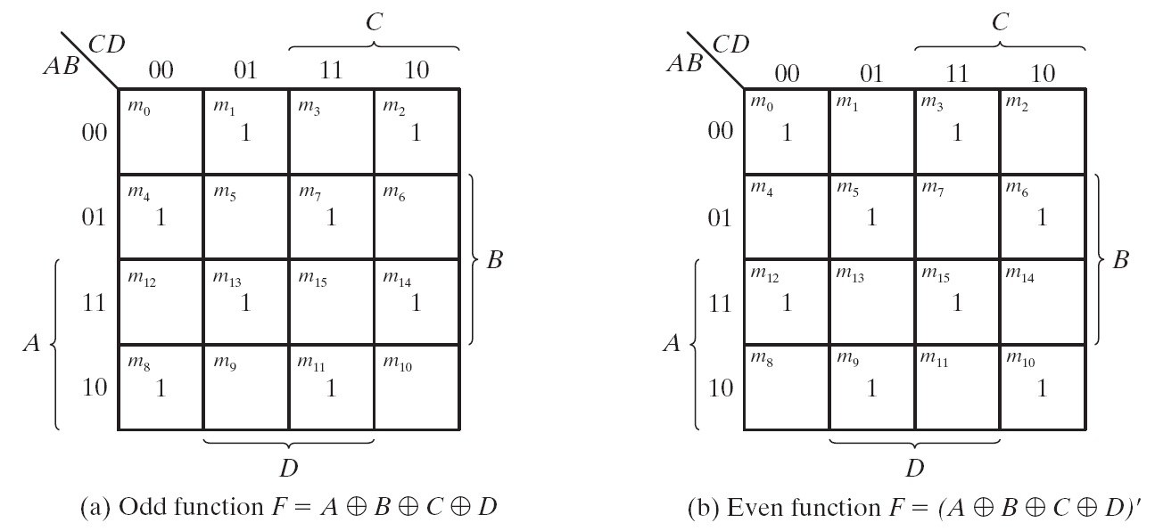
Four-variable Exclusive-OR function
Figure 3.35 Map for a Four-variable Exclusive-OR Function
Four-variable Exclusive-OR function
A⊕B⊕C⊕D = (AB'+A'B)⊕(CD'+C'D) = (AB'+A'B)(CD+C'D')+(AB+A'B')(CD'+C'D)

Slide 51
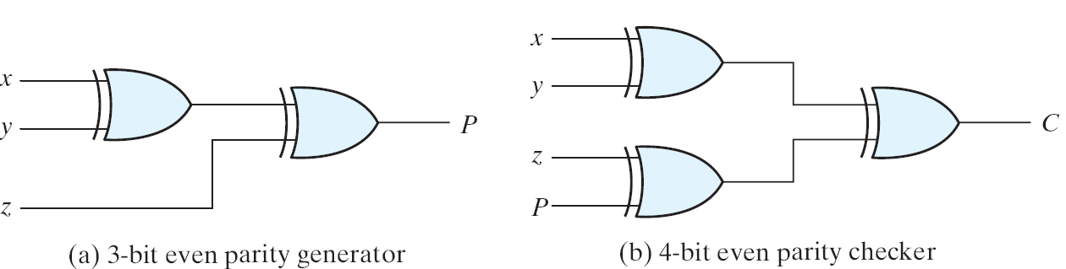
Parity Generation and Checking
Figure 3.36 Logic Diagram of a Parity Generator and Checker
Parity Generation and Checking
A parity bit: P = x⊕y⊕z
Parity check: C = x⊕y⊕z⊕P
C=1: one bit error or an odd number of data bit error
C=0: correct or an even # of data bit error

Slide 52
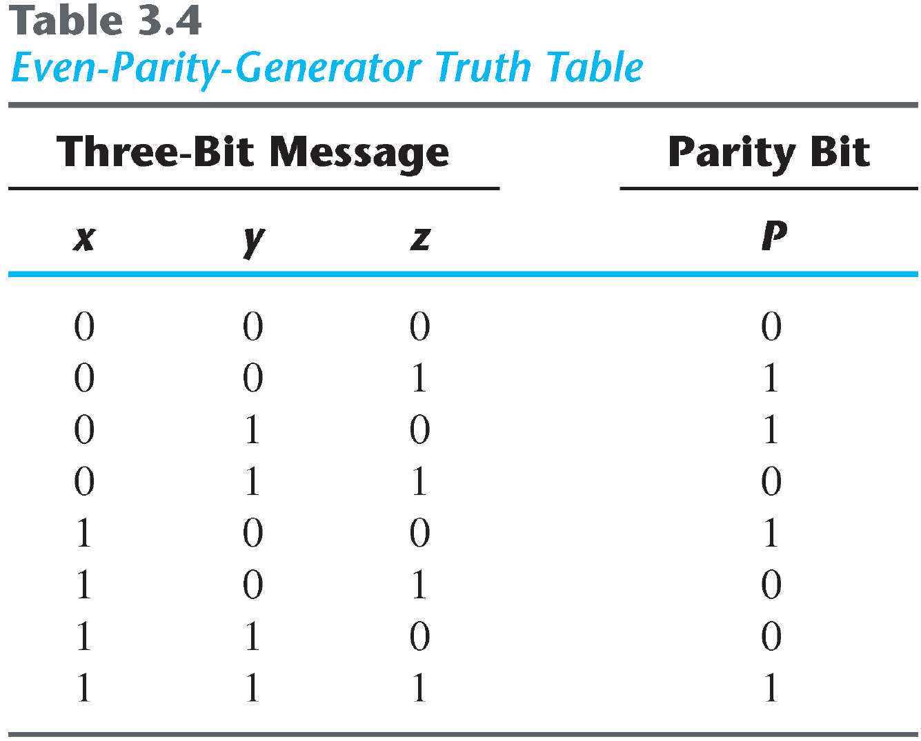
Parity Generation and Checking

Slide 53
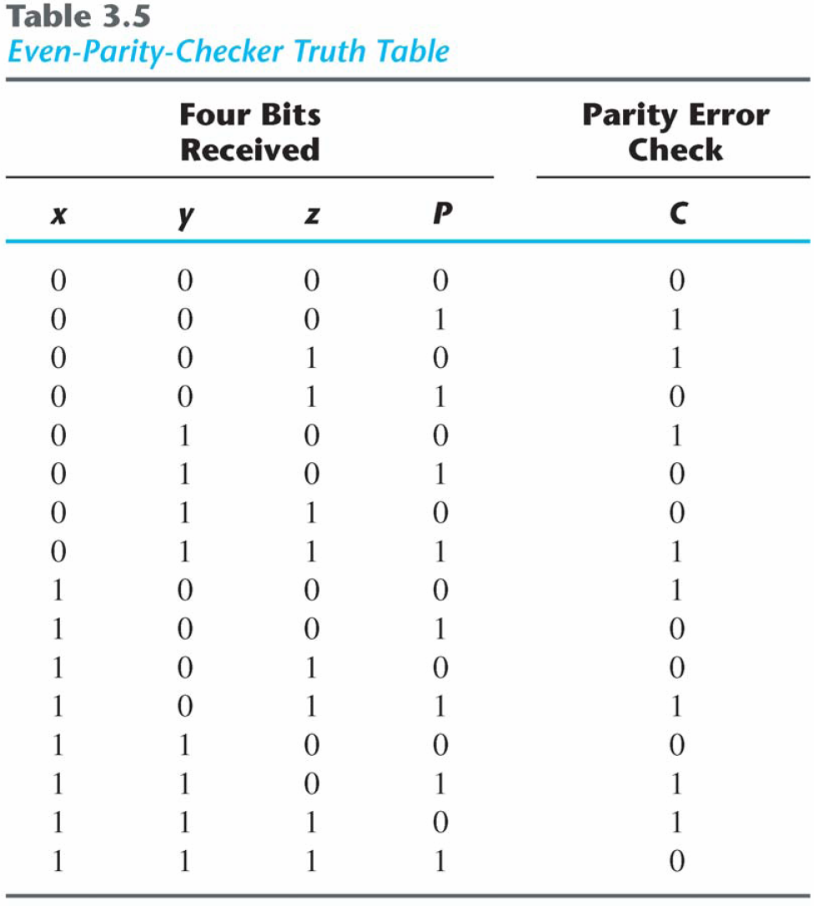
Parity Generation and Checking

Slide 54
3.10 Hardware Description Language (HDL)
Describe the design of digital systems in a textual form
Hardware structure
Function/behavior
Timing
VHDL and Verilog HDL

Slide 55
A Top-Down Design Flow
Specification
RTL design and
Simulation
Logic Synthesis
Gate Level Simulation
ASIC Layout
FPGA Implementation

Slide 56
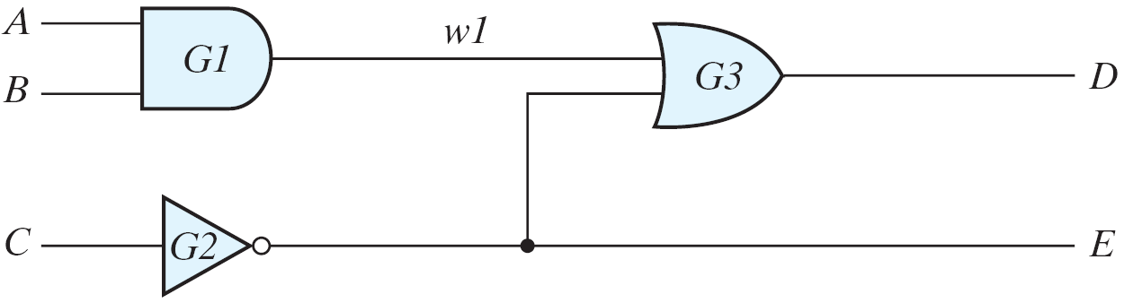
Module Declaration
Figure 3.37 Circuit to demonstrate an HDL
Examples of keywords:
module, end-module, input, output, wire, and, or, and not

Slide 57
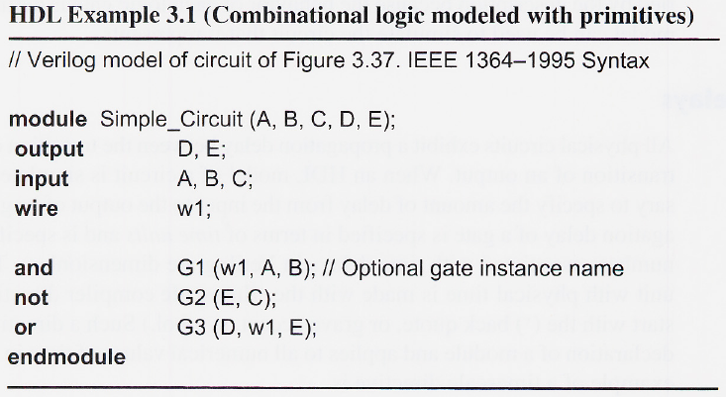
HDL Example 3.1
HDL description for circuit shown in Fig. 3.37

Slide 58
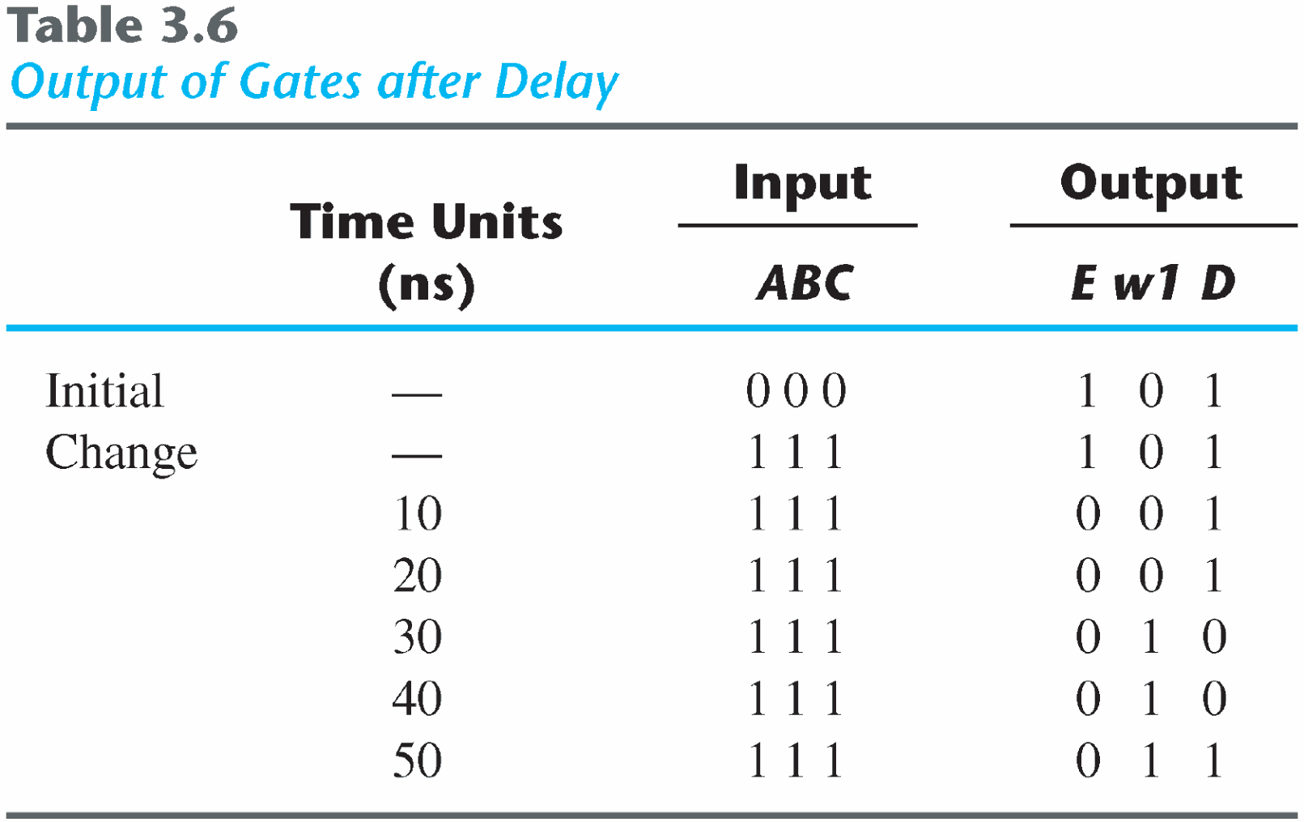
Gate Displays
Example: timescale directive
‘timescale 1 ns/100ps

Slide 59
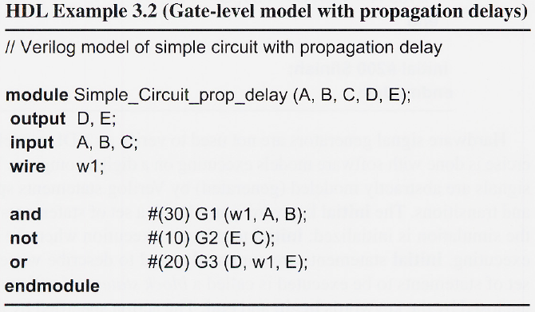
HDL Example 3.2
Gate-level description with propagation delays for circuit shown in Fig. 3.37

Slide 60
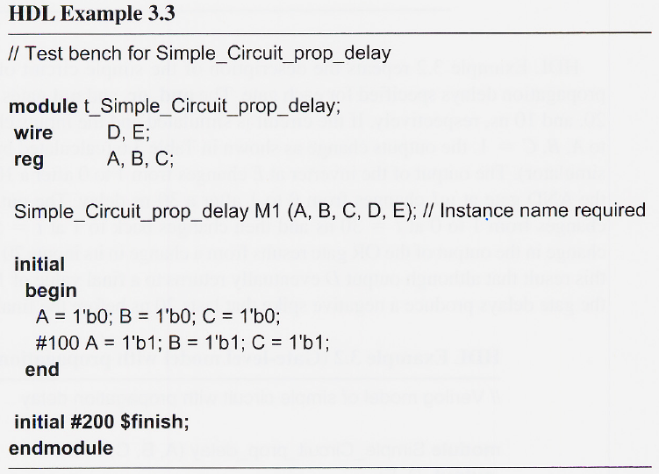
HDL Example 3.3
Test bench for simulating the circuit with delay

Slide 61
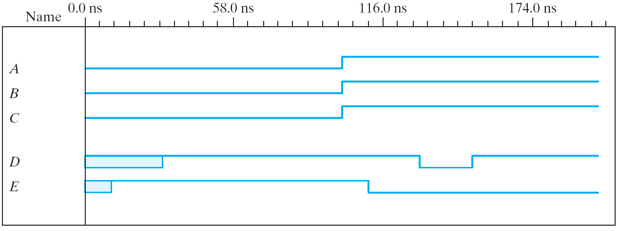
Simulation output for HDL Example 3.3

Slide 62

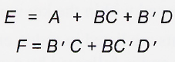
Boolean Expression
HDL Example 3.4
Boolean expression for the circuit of Fig. 3.37
Boolean expression:

Slide 63
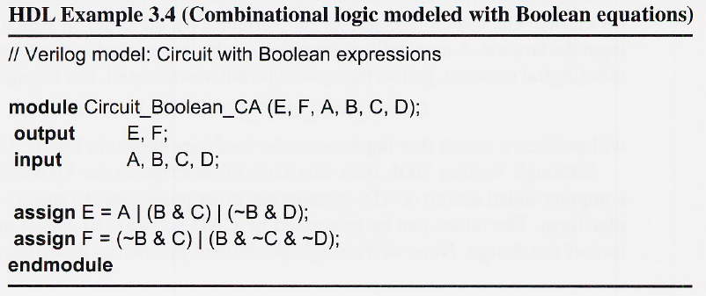
HDL Example 3.4

Slide 64
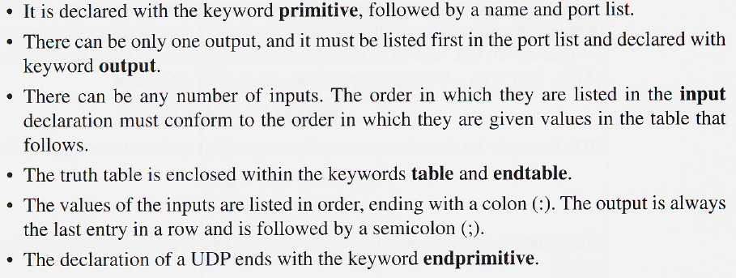
User-Defined Primitives
General rules:
Declaration:
Implementing the hardware in Fig. 3.39

Slide 65

HDL Example 3.5

Slide 66

HDL Example 3.5 Continued)

Slide 67

Figure 3.39 Schematic for circuit with_UDP_02467

